Slide 1
Theory and Algorithms for Formal Verification $ω$-Regular Languages and Büchi Automata
Spring 2024: CSCI 699
Instructor: Jyo Deshmukh

Slide 2
Finite State Automata
A finite state automaton $A$ is a tuple $\left(Q,Σ,δ,Q_{0}, F\right)$ where:
$Q$is a finite, non-empty set of states
$Σ$ is a finite alphabet of symbols (read by the automaton)
$δ:Q×Σ→2^{Q}$ is a transition relation
$Q_{0}⊆Q$ is a set of initial states
$F⊆Q$ is a set of final states
Size of $A$ is $\left|Q\right|+\sum_{q∈Q }{\sum_{a∈Σ}{\left|δ(q,a)\right|}}$
Convenient to say $q\underset{→}{a}q^{′}$ if $q^{′}∈δ(q,a)$

Slide 3
Deterministic vs. Nondeterministic Finite Automata
Automaton definition on previous slide allows nondeterminism
There can be multiple possible initial states
For any given $q∈Q$ and $a∈Σ$, in general $\left|δ\left(q,a\right)\right|>1$
In general automaton can have moves on an empty symbol (also called $ε$-transitions) : i.e. state changes from $q$ to $q′$ without “reading” a new symbol
Deterministic Finite-state Automaton (DFA):
$\left|Q_{0}\right|=1$
For all $q∈Q, a∈A$, $\left|δ(q,a)\right|≤1$
No transitions on empty symbols

Slide 4
Run of an automaton
The run of an NFA on a given word $w=a_{1}a_{2}…a_{n}$ is the finite sequence of states $q_{0}q_{1}…q_{n}$ s.t.
$q_{0}∈Q_{0}$
For all $i∈\left[0,n−1\right]:q_{i}\underset{→}{a_{i+1}}q_{i+1}$
A run $q_{0}q_{1}…q_{n}$ of an NFA is called an accepting run iff $q_{n}∈F$
A finite word $w$ is accepted by the NFA if there exists an accepting run
Language of the automaton $A$ (denoted $ℒ(A)$) is defined as:
$$ℒ\left(A\right)=\left\{ w∈Σ^{∗} ∣ there is an accepting run for w in A\right\}$$

Slide 5
NFA example
$$w=abbaab$$
$ρ_{1}\left(w\right)= q_{0}\underset{→}{a}q_{0}$ $\underset{→}{b}q_{0}$ $\underset{→}{b}q_{0}$ $\underset{→}{a}q_{0}$ $\underset{→}{a}q_{0}$ $\underset{→}{b}q_{0}$
$ρ_{2}\left(w\right)= q_{0}\underset{→}{a}q_{0}$ $\underset{→}{b}q_{0}$ $\underset{→}{b}q_{0}$ $\underset{→}{a}q_{1}$ $\underset{→}{a}q_{r}$ $\underset{→}{b}q_{r}$
$ρ_{3}\left(w\right)= q_{0}\underset{→}{a}q_{0}$ $\underset{→}{b}q_{0}$ $\underset{→}{b}q_{0}$ $\underset{→}{a}q_{0}$ $\underset{→}{a}q_{1}$ $\underset{→}{b}q_{f}$
Automaton accepts the word because there is an accepting run
a/b
$$q_{0}$$
a
$$q_{1}$$
b
$$q_{f}$$
a
$$q_{r}$$
a/b

Slide 6
DFA
DFAs are called total if $\left|Q_{0}\right|=1$ and $\left|δ\left(q,a\right)\right|=1$ for all $q∈Q,a∈Σ$
Run of a DFA: there is only one run for each input word
If the (only) run is accepting, the DFA accepts the word, otherwise rejects
NFA to DFA conversion can be done by “subset construction”

Slide 7
Determinizing finite state automata
NFA transition relation maps state $q$ and a symbol $a$ to a subset of $2^{Q}$
E.g., $δ\left(q,a\right)=\{q_{1},q_{2}\}$
Main idea: make every such subset a new state
E.g.: $Q=\{q_{1},q_{2}\}$, $R=\left\{\underset{r_{1}}{\underbrace{∅}},\underset{r_{2}}{\underbrace{\left\{q_{1}\right\}}},\underset{r_{3}}{\underbrace{\left\{q_{2}\right\}}},\underset{r_{4}}{\underbrace{\left\{q_{1},q_{2}\right\}}}\right\}$
If $A_{det}$ is in state $r_{i}$, then $A_{det}$ moves to a new state $r_{j}= ∪_{q∈r_{i}}δ\left(q,a\right)$
Mark any subset that contains a final state as final
Formally, $A_{det}$ = $\left(2^{Q},Σ, δ_{det},r_{0},F_{det}\right)$, where:
$r_{0}=\{Q_{0}\}$,
$F_{det}=\left\{r⊆Q ∣ r∩F≠∅\right\}$
$δ_{det}\left(r,a\right)= \bigcup_{q∈r}{δ\left(q,a\right)}$
Note: size of DFA is exponential in the size of the NFA! (exponentially more states)

Slide 8
Regular expressions
Given a finite alphabet $Σ$, a word over $Σ$ is a finite or infinite sequence of symbols in $Σ$ of the form $a_{1}a_{2}…$
Length of a word $w$(denoted $\left|w\right|$) is the number of symbols in it
Words of length $0$ are allowed! Empty word denoted by symbol $ε$ (epsilon)
Syntax for regular expressions (here $a$ is an arbitrary symbol from $Σ$)
$$E ∷= ∅∣ε∣a∣E+E∣E.E∣E^{∗}$$
Semantics of a regular expression is a language (set of finite words) defined as:
$ℒ\left(∅\right)=∅$, $ℒ\left(ε\right)=\left\{ε\right\}$, $ℒ\left(a\right)=\{a\}$
$ℒ\left(E_{1}+E_{2}\right)=ℒ\left(E_{1}\right)∪ℒ\left(E_{2}\right)$ [Disjunction]
$ℒ\left(E_{1}.E_{2}\right)=\left\{uv ∣ u∈ℒ\left(E_{1}\right), v∈ℒ\left(E_{2}\right)\right\}$ [Concatenation]
$ℒ\left(E^{∗}\right)= \bigcup_{i∈ℕ }{\left\{u^{i}∣u∈ℒ(E)\right\}}$ : $u^{i}$ is short-hand for$i$ repetitions of $u$ [Kleene-star]

Slide 9
Regular Language & NFAs
$Σ=\left\{a,b,c\right\}$
${E= \left(a+c\right)}^{∗}ba^{∗}$
$ℒ\left(E\right)=\{b,ab,cb,aab,acb,aba,aaaccccaaccbbaaaa,…\}$
A language $L⊆Σ^{∗}$ is regular if there is some regular expression $E$over $Σ$ s.t. $ℒ\left(E\right)= L$
Theorems:
Regular languages are closed under complement, union, intersection and Kleene-star
Any language accepted by an NFA is a regular language
For any NFA $A$, you can generate a regular expression for $ℒ(A)$
For any regular expression $E$, you can construct an NFA that accepts precisely $ℒ\left(E\right)$

Slide 10
Are these languages regular?
$Σ=\{a,b\}$
$S=\{a^{n}b^{n}∣n≥0\}$
is a context-free language: not regular
$S=\left\{ww^{R} \right|w ∈Σ^{∗}\}$
is a context-free language: not regular
$S=\left\{ww ∣ w∈Σ^{∗}\right\}$
is a context-sensitive language: not regular

Slide 11
Synchronous product of two NFAs
Given $A_{1}=\left(Q_{1},Σ,δ_{1},Q_{0,1},F_{1}\right)$ and $A_{2}=\left(Q_{2},Σ,δ_{2},Q_{0,2},F_{2}\right)$, the product automaton $A_{p}=A_{1}⊗A_{2}$ is the automaton accepting the intersection of the languages of $A_{1}$ and $A_{2}$, i.e.,
$$ℒ\left(A_{1}⊗A_{2}\right)=ℒ\left(A_{1}\right)∩ℒ\left(A_{2}\right)$$
$A_{p}=\left(Q_{1}×Q_{2},Σ, δ_{p}, Q_{0,1}×Q_{0,2},F_{1}×F_{2}\right)$
$δ_{p}\left(\left(q_{1},q_{2}\right),a\right)=(q_{1}^{′},q_{2}^{′})$ iff$q_{1}^{′}∈δ_{1}\left(q_{1},a\right)$and$q_{2}^{′}∈δ_{2}\left(q_{2},a\right)$
For each $q_{1} in Q_{1}$
For each $q_{2} in Q_{2}$
$for a∈Σ$
Q_next1 = $δ_{1}(q_{1},a)$
Q_next2 = $δ_{2}\left(q_{2},a\right)$
$q_{1}^{′}∈Q_next1$, $q_{2}^{′}∈Q_next2$
$δ_{p}\left(\left(q_{1},q_{2}\right), a\right)=$

Slide 12
Checking emptiness of NFA
$ℒ\left(A\right)$ is nonempty iff there exists some run of the NFA that ends in a final (accepting) state
To check emptiness:
ignore the labels on the automaton transitions
check if a final state is reachable from an initial state
reachability can be checked in $O\left(\left|A\right|\right)$ time using depth-first search
using space that is logarithmic in $|A|$

Slide 13
Complementation of an NFA
Recipe to complement NFAs:
Determinize the NFA (convert to a DFA)
Complement the DFA
Complementation of a DFA is straightforward
Just set all states in $Q∖F$to be final states

Slide 14
Decision problems for automata
Equivalence
Given two automata $A_{1}$ and $A_{2}$ : is $ℒ\left(A_{1}\right)=ℒ\left(A_{2}\right)$?
Membership
Given a word $w$, is $w∈ℒ(A)$?
Emptiness
Is $ℒ\left(A\right)=∅$?
Universality
Is $ℒ\left(A\right)=Σ^{∗}$?
For NFAs/DFAs: all problems are decidable in Logspace

Slide 15
Regular safety properties
Safety property over $2^{AP}$ is called regular if the set of bad finite prefixes of $P_{safe}$ is a regular language
So: we can encode $BadPrefixes\left(P_{safe}\right)$ as an automaton $A_{¬safe}$
Invariants are regular safety properties: set of bad finite prefixes: $Φ^{∗}\left(¬Φ\right)true^{∗}$

Slide 16
Verification of regular safety properties
Check if $TS ⊨P_{safe}$ can be done by checking if:
$Traces_{fin}\left(TS\right)∩BadPrefixes\left(P_{safe}\right)=∅$
I.e., we can check if $Traces_{fin}\left(TS\right)∩ℒ\left(A_{¬safe}\right)=∅$
Construct a new LTS that is the synchronous product of $TS$ with $A_{¬safe}$
Check for reachability of certain states in $TS⊗A_{¬safe }$

Slide 17
Synchronous product of $TS$ with $A_{¬safe}$
$TS=\left(S,Act, →,I, AP, L\right)$ , $A_{¬safe}=(Q,2^{AP},δ, Q_{0},F)$
$TS⊗A_{¬safe }=\left(S^{′},Act,→,I^{′},AP^{′},L′\right)$ where:
$S^{′}=S×Q$
$→^{′}$ is the smallest relation s.t.:
$\left(s,q\right) \underset{→}{α}′$ $\left(s^{′},q^{′}\right)$ if : $\left(s,α,s^{′}\right) ∈ →$ and $\left(q,L\left(s^{′}\right),q^{′}\right)∈δ$
I.e., the “property automaton” makes moves consistent with labels of $s′$
$I^{′}=\{\left(s_{0},q\right)∣s_{0}∈I∧∃q_{0}∈Q_{0}$ s.t. $q_{0}\underset{→}{L\left(s_{0}\right)} q\}$ : initial state label
$AP^{′}=Q$
$L^{′}:S×Q→2^{Q}$ is given by $L^{′}\left(\left(s,q\right)\right)=\{q\}$

Slide 18
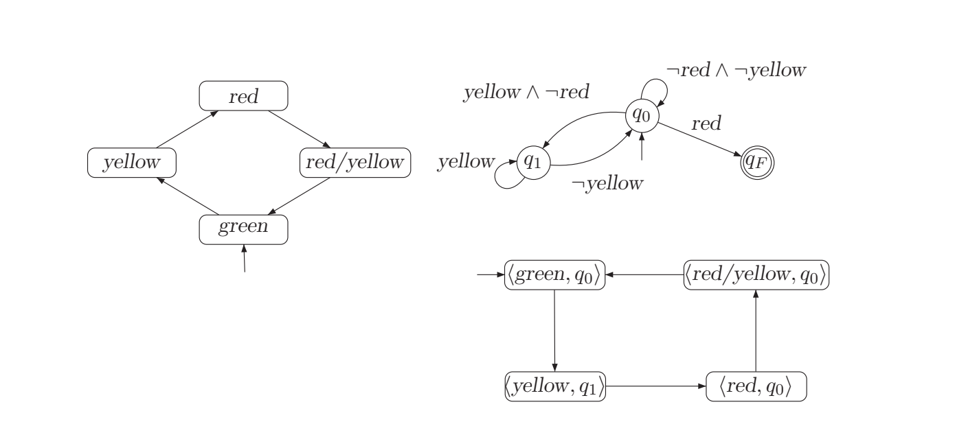
Example from [BK] book

Slide 19
Reducing verification of regular safety properties to checking invariants
Construct new invariant: $P_{inv\left(A_{¬safe}\right)}=\bigwedge_{q∈F}{¬q}$
Theorem: Following statements are equivalent:
$TS⊨P_{safe}$
$Traces_{fin}\left(TS\right)∩ℒ\left(A_{¬safe}\right)=∅$
$TS⊗ℒ\left(A_{¬safe}\right)⊨P_{inv\left(A_{¬safe}\right)}$
Last statement is useful to get an algorithm:
Check if the invariant we constructed above is true (using algorithm for checking invariants using DFS)
If a state violates this invariant, it means a “bad” state is reachable in the product

Slide 20
Complexity of verification of regular safety properties
$O\left(\left|TS\right||A_{¬safe }|\right)$ : follows from the complexity of invariant checking problem

Slide 21
$ω$-Regular Languages
$ω$-Regular languages: Regular languages along with infinite repetition
$ω$-Regular Expressions:
Syntax:
$E_{1}⋅F_{1}^{ω}+E_{2}.F_{2}^{ω}+ …E_{n}.F_{n}^{ω}$ where $E_{i}, F_{i}$ are regular expressions
Semantics: $\bigcup_{1≤i≤n}{ℒ\left(E_{i}\right)⋅ℒ{\left(F_{i}\right)}^{ω}}$
Examples: ${\left(a+b\right)}^{∗}ab^{ω}$
$ω$-regular language : language for some $ω$-regular expression

Slide 22
$ω$-Regular Languages and Properties
Examples:
Infinite length words that contain infinitely many a’s
Infinite length words that contain only a finite number of $a$’s
Infinite length words that contain only a finite number of $a$’s and an infinite number of $b$’s
Mutual exclusion, starvation freedom, fairness, many liveness properties are $ω$-regular properties

Slide 23
Büchi automata
Nondeterministic Büchi automaton (NBA) is a tuple $A=(Q,Σ, δ,Q_{0},F)$ where:
$Q$ is a finite set of states
$Σ$ is a finite alphabet
$δ:Q×Σ→2^{Q}$ is a transition function
$Q_{0}⊆Q$ is a set of initial states
$F⊆Q$ is a set of accepting states also called the acceptance set
0
$$Q=\left\{q_{0},q_{1},q_{f}\right\}$$
$$Σ=\left\{0,1\right\}$$
$$F=\left\{q_{f}\right\}$$
$$Q_{0}=\{q_{0}\}$$
0/1
$$q_{0}$$
0
$$q_{f}$$
0/1
1
$$q_{1}$$

Slide 24
Run of an NBA
Run over a word $σ∈Σ^{ω}$ is an infinite sequence of states
$$ρ\left(σ\right)=q_{0}q_{1}q_{2}…$$
Let $\inf\left(ρ\right)$ denote the set of states that appear infinitely often in $ρ$
A run is called accepting if $\inf\left(ρ\right)∩F≠∅$
I.e., if some state in $F$ appears infinitely often along the run
0/1
0
0
$$q_{0}$$
$$q_{f}$$
0/1
1
$$q_{1}$$
Run on ${σ_{1}= 0}^{ω}$:
$$ρ_{1}=q_{0}q_{0}q_{0}q_{f}q_{f}…$$
$$ρ_{2}=q_{0}q_{0}q_{0}…$$
Automaton accepts $σ_{1}$ as there exists an accepting run

Slide 25
Run of an NBA
Run over a word $σ∈Σ^{ω}$ is an infinite sequence of states
$$ρ\left(σ\right)=q_{0}q_{1}q_{2}…$$
Let $\inf\left(ρ\right)$ denote the set of states that appear infinitely often in $ρ$
A run is called accepting if $\inf\left(ρ\right)∩F≠∅$
I.e., if some state in $F$ appears infinitely often along the run
0/1
0
0
$$q_{0}$$
$$q_{f}$$
0/1
1
$$q_{1}$$
Run on ${σ_{2}=010100}^{ω}$:
$ρ_{1}=q_{0}q_{0}q_{0}q_{f}q_{f}…$ : accepting
$ρ_{2}=q_{0}q_{0}q_{f}q_{1}q_{1}…$ : not accepting
Automaton accepts $σ_{2}$ as there exists an accepting run

Slide 26
Run of an NBA
Run over a word $σ∈Σ^{ω}$ is an infinite sequence of states
$$ρ\left(σ\right)=q_{0}q_{1}q_{2}…$$
Let $\inf\left(ρ\right)$ denote the set of states that appear infinitely often in $ρ$
A run is called accepting if $\inf\left(ρ\right)∩F≠∅$
I.e., if some state in $F$ appears infinitely often along the run
0/1
0
0
$$q_{0}$$
$$q_{f}$$
0/1
1
$$q_{1}$$
Run on $σ_{3}$: infinitely many 1’s e.g.: $010101..$
$ρ_{1}=q_{0}\underset{→}{0}q_{0}\underset{→}{1}q_{0}\underset{→}{0}q_{0}\underset{→}{1}q_{0}\underset{→}{0}q_{f}q_{0}\underset{→}{1}q_{1}\underset{→}{∗}q_{1}…$: not accepting
$ρ_{2}=q_{0}q_{0}q_{0}q_{0}q_{0}q_{f}q_{1}…$ : not accepting
Automaton does not accept $σ_{3}$ as there is no accepting run!

Slide 27
Language of an NBA
NBA $A$ accepts $σ$ if there exists a run of $A$ on $σ$ that is accepting
NBA $A$ is called empty if it does not accept any word
Language of an NBA $ℒ_{ω}\left(A\right)$ is the set of all words accepted by the NBA
Theorem:
Class of languages accepted by NBAs agrees with the class of $ω$-Regular languages

Slide 28
Proof
Show that for any NBAs $A_{1}$ and $A_{2}$, there is an NBA that accepts the language $ℒ_{ω}\left(A_{1}\right)∪ℒ_{ω}(A_{2})$
Show that for any regular language (of finite words) accepted by an NFA $A$, with $ε∉ℒ(A)$, there is an NBA that accepts ${\left(ℒ(A)\right)}^{ω}$
Show that for any regular language (accepted by NFA $A$) and NBA $A′$, there exists an NBA that accepts $ℒ(A)⋅ℒ_{ω}(A′)$
Basically: if we can show the above 3 properties, it shows that we can construct an NBA from any $ω$-regular expression

Slide 29
Union operator on NBAs
$A_{1}=\left(Q_{1},Σ, δ_{1},Q_{0,1},F_{1}\right)$
$A_{2}=\left(Q_{2},Σ, δ_{2},Q_{0,2},F_{2}\right)$
W.l.o.g. $Q_{1}∩Q_{2}=∅$
Then $A$ s.t. $ℒ\left(A\right)=ℒ\left(A_{1}\right)∪ℒ\left(A_{2}\right)$ is defined as: $(Q^{′},Σ,δ^{′},Q_{0}^{′},F^{′})$ where:
$Q^{′}=Q_{1}∪Q_{2}$
For each $q∈Q_{i} and a∈Σ:$ $δ^{′}\left(q,a\right)=δ_{i}(q,a)$
$Q_{0}^{′}=Q_{0,1}∪Q_{0,2}$
$F^{′}=F_{1}∪F_{2}$

Slide 30
$ω$ operator for NFAs
For each NFA $A$ with $ε∉L(A)$, there is an NBA $A^{′}$s.t.
$ℒ_{ω}\left(A^{′}\right)={\left(ℒ\left(A\right)\right)}^{ω}$
Assume $A$ is an NFA where initial states have no incoming transitions and initial states are not accepting, i.e., $Q_{0}∩F=∅$
Can always convert an NFA not in this form to this form
For any transition in $A$ leading to an accept state (in $A$), add edges back to the initial states of $A$

Slide 31
Concatenation of NFA and an NBA
NFA $A=(Q,Σ, δ,Q_{0},F)$
NBA $A^{′}=\left(Q^{′},Σ,δ^{′},Q_{0}^{′},F^{′}\right)$
Define NBA $A^{′′}=\left(Q^{′′}, Σ, δ^{′′},Q_{0}^{′′},F^{′′}\right)$:
$Q^{′′}=Q∪Q^{′}$
$Q_{0}^{′′}=\left\{\begin{aligned}Q_{0} if Q_{0}∩F=∅ \\ Q_{0}∪Q_{0}^{′} otherwise \end{aligned}\right.$
$δ^{′′}\left(q,a\right)= \left\{\begin{aligned}δ(q,a) \\ δ\left(q,a\right)∪Q_{0}^{′} \\ δ′(q,a)\end{aligned}\right.$ $\begin{matrix}if q∈Q and δ\left(q,a\right)∩F=∅ \\ if q∈Q and δ\left(q,a\right)∩F≠∅ \\ if q∈Q^{′}\end{matrix}$
$F^{′′}=F′$

Slide 32
Non-emptiness of NBAs
Given $A=\left(Q,Σ, q_{0},δ, F\right)$, following statements are equivalent:
$ℒ_{ω}\left(A\right)≠∅$
There exists a reachable state in $F$ that belongs to a cycle in $A$. Formally:
$∃q_{0}∈Q_{0}:∃q∈F: ∃u∈Σ^{∗}:∃v∈Σ^{+}:q∈δ^{∗}\left(q_{0},u\right)∩δ^{∗}(q_{0},uv)$
In the above statement u$v$ is the word with a finite “stem” $u$and a repeating part $v$ i.e., it accepts infinite word of the form $uv^{ω}$
Algorithm: check if there is a cycle containing a state in $F$
Complexity is $O\left(|A|\right)$

Slide 33
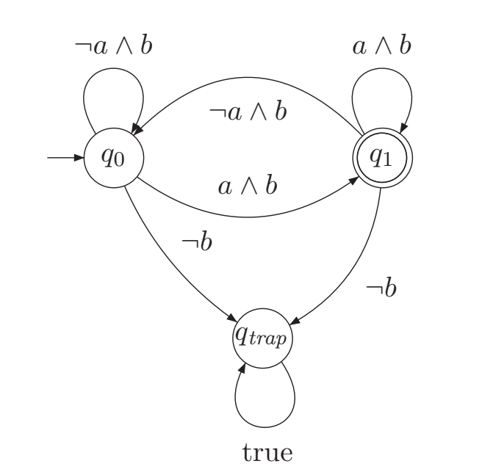
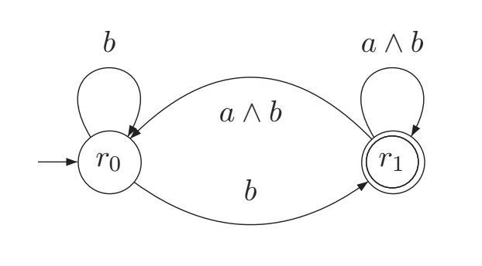
Deterministic Büchi automata
An NBA $A=(Q, Σ, δ, Q_{0},F)$ is called a deterministic Büchi automaton (DBA) if:
$\left|Q_{0}\right|≤1$
$\left|δ\left(q,a\right)\right|≤1$ for all $q∈Q$ and $a∈Σ$
DBA and its equivalent NBA example

Slide 34
NBAs are more expressive than DBAs
Theorem: There does not exist a DBA $A$ such that $ℒ_{ω}\left(A\right)=ℒ_{ω}\left({\left(0|1\right)}^{∗}1^{ω}\right)$
Proof by contradiction
Since $σ_{1}=1^{ω}$ belongs to $ℒ_{ω}\left(A\right)$, there exists an accepting state $q_{f}^{1}∈F$ and an $n_{1}∈ℕ^{≥1}$ s.t. $δ^{∗}\left(q_{0},σ_{1}\right)=q_{f}^{1}$ (which is uniquely determined as $A$ is det.)
Since $σ_{2}=1^{n_{1}}{01}^{ω} belongs to { ℒ}_{ω}\left(A\right)$, there exists an accepting state $q_{f}^{2}∈F$ and $n_{2}∈ℕ^{≥1 }$ s.t. $δ^{∗}\left(q_{0},σ_{2}\right)=q_{f}^{2}$
As the word $σ_{3}=1^{n_{1}}{01}^{n_{2}}{01}^{ω}∈ℒ_{ω}(A)$, there is some $q_{f}^{3}$ and $n_{3}∈ℕ^{≥1}$ s.t. $δ^{∗}\left(q_{0},σ_{3}\right)=q_{f}^{3}$
We can continue this and get sequence of states $q_{f}^{1}$, $q_{f}^{2},…$ s.t. $δ^{∗}\left(q_{0},1^{n_{1}}{01}^{n_{2}}0…1^{n_{i}}\right)=q_{f}^{i}$
As there is only a finite number of states, at some point, the states must be the same. So, there are some $i,j, i<j$ s.t. $δ^{∗}\left(q_{0},1^{n_{1}}{01}^{n_{2}}…01^{n_{i}}\right)=δ^{∗}\left(q_{0},1^{n_{1}}{01}^{n_{2}}…1^{n_{i}}0…{01}^{n_{j}}\right)$
This means $A$accepts $\left(1^{n_{1}}{01}^{n_{2}}…{01}^{n_{i}}\right){\left({01}^{n_{i+1}}0…{01}^{n_{j}}\right)}^{ω}$ : but this string has an infinite number of 0’s which is a contradiction

Slide 35
Product construction of NBA
$A_{1}=\left(Q_{1},Σ, δ_{1}, Q_{0,1},F_{1}\right)$ $⊗$ $A_{2}= (Q_{2},Σ, δ_{2}, Q_{0,2},F_{2})$
$A_{p}=\left(\underset{Q_{p}}{\underbrace{\boxed{Q_{1}×Q_{2}×\left\{1,2\right\}}}},Σ, δ_{p},\underset{Q_{0,p}}{\underbrace{\boxed{Q_{0,1}×Q_{0,2}×\left\{1\right\}}}}, \underset{F_{p}}{\underbrace{\boxed{\left\{\left(q_{1},q_{2},2\right) ∣ q∈Q_{1},q^{′}∈F_{2}\right\}}}}\right)$
$δ_{p}\left(\left(q_{1},q_{2},1\right), a\right)=\left(q_{1}^{′},q_{2}^{′},i\right)$
If $\left(q_{1},a,q_{1}^{′}\right)∈δ_{1}$, $\left(q_{2},a,q_{2}^{′}\right)∈δ_{2}$ and if $q_{1}∈F_{1},$ then $i=2$ else $i=1$
$δ_{p}\left(\left(q_{1},q_{2},2\right), a\right)=\left(q_{1}^{′},q_{2}^{′},i\right)$
If $\left(q_{1},a,q_{1}^{′}\right)∈δ_{1}$, $\left(q_{2},a,q_{2}^{′}\right)∈δ_{2}$ and if $q_{2}∈F_{2},$ then $i=1$ else $i=2$

Slide 36
What is happening in the product?
In DFA/NFA product construction, it is enough to reach a final state that is in $F_{1}×F_{2}$ : this is not the case for NBA!
An accepting run of the product NBA:
Is an accepting run in NBA $A_{1}$ : some state in $F_{1}$ is visited infinitely often
Is an accepting run in NBA $A_{2}$ : some state in $F_{2}$ is visited infinitely often
Idea:
make product start in a state which “looks” for reaching an accepting state in $F_{1}$
once it is reached, it transitions to a state that starts “looking” for an accepting state in $F_{2}$
once this is reached, it transitions back to “looking” for accepting state in $F_{1}$
For every infinite run that is accepting in the product, it will encounter both accepting states in $F_{1}$ and $F_{2}$ infinitely often

Slide 37
Illustration of product
0/1
0
0
$$q_{0}$$
$$q_{f}$$
$$A_{1}$$
0/1
$${ℒ_{ω}\left(A_{1}\right)= \left(0 | 1\right)}^{∗}0^{ω}$$
1
$$q_{1}$$
$$A_{2}$$
0
1
0 | 1
$${ℒ_{ω}\left(A_{2}\right)=0}^{∗}1{\left(0|1\right)}^{ω}$$
$$s_{0}$$
$$s_{f}$$

Slide 38
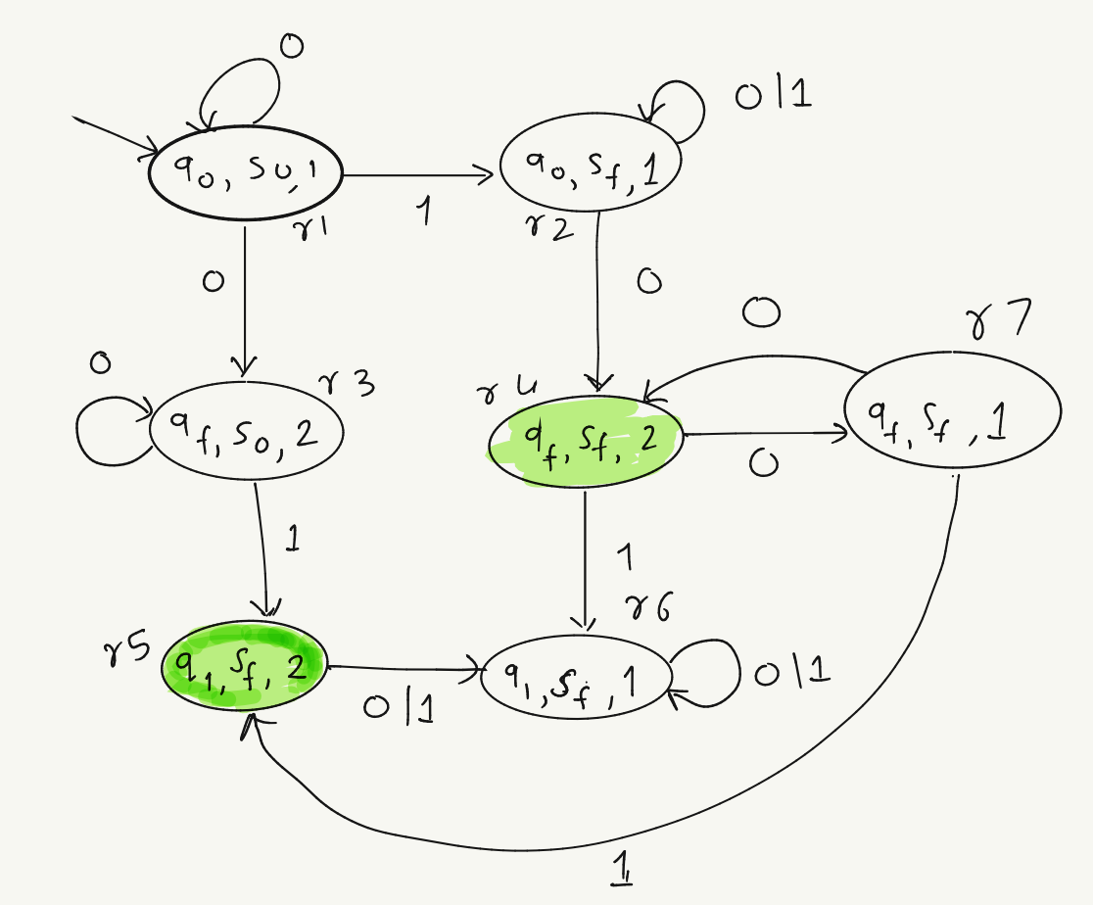
Illustration of product
$$A_{1}$$
0/1
$$q_{0}$$
0
$$q_{f}$$
0
0/1
1
$$q_{1}$$
$$A_{2}$$
0 | 1
$${ℒ_{ω}\left(A_{p}\right)=0}^{∗}1{\left(0 | 1\right)}^{∗}0^{ω}$$
0
$$s_{0}$$
1
$$s_{f}$$
$${ℒ_{ω}\left(A_{1}\right)= \left(0 | 1\right)}^{∗}0^{ω}$$
I.e., words containing at least one $1$ followed by arbitrary finite suffixes, followed by an infinite string of only 0s
Satisfies “eventually 1 and eventually always 0”
$${ℒ_{ω}\left(A_{2}\right)=0}^{∗}1{\left(0|1\right)}^{ω}$$

Slide 39
Generalized Büchi automata
Generalized Nondeterministic Büchi automaton (GNBA) is a tuple $A=(Q,Σ, δ,Q_{0},F)$ where:
$Q$ is a finite set of states
$Σ$ is a finite alphabet
$δ:Q×Σ→2^{Q}$ is a transition function
$Q_{0}⊆Q$ is a set of initial states
Acceptance condition specified as a set $ℱ=\{F_{1},…, F_{k}\}$, where each $F_{j}$ is a finite subset of $Q$
Each $F_{j}$ is called an acceptance set

Slide 40
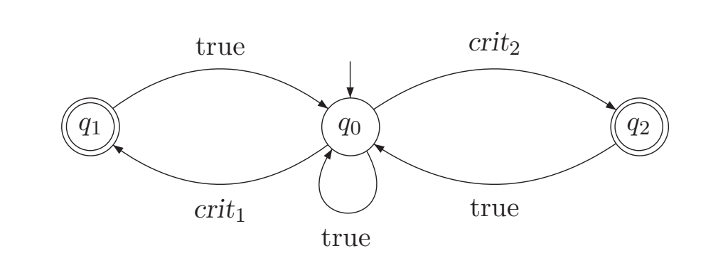
Run of GNBA
An infinite run $ρ= q_{0}q_{1}…$ of a GNBA is called accepting if:
$$∀F∈ℱ:inf\left(ρ\right)∩F≠∅$$
In other words, there should be at least one state from each accepting set that appears infinitely often in a run
A GNBA accepts a string $σ$ if there exists an accepting run of the GNBA on $σ$
$Q=\left\{q_{0},q_{1},q_{2}\right\}$
$ℱ=\{\left\{q_{1}\right\},\left\{q_{2}\right\}\}$
i.e. $F_{1}=\left\{q_{1}\right\}, F_{2}=\{q_{2}\}$
$A$ accepts all strings where both $crit_{1}$and $crit_{2}$ are true infinitely often

Slide 41
GNBA – NBA equivalence
Theorem: For each GNBA $G$, there is an NBA $A$ s.t. $ℒ_{ω}\left(G\right)=ℒ_{ω}\left(A\right)$ and $\left|A\right|=O\left(\left|G\right|⋅\left|ℱ\right|\right)$
Proof: Let $G=\left(Q,Σ, δ, Q_{0},ℱ\right),$ where $ℱ=\left\{F_{1},…, F_{k}\right\}$
Let $A=(Q^{′},Σ,δ^{′},Q_{0}^{′}, F^{′})$ where:
$Q^{′}=Q×\{1,…, k\}$
$Q_{0}^{′}=Q_{0}×\{1\}$
$F^{′}=F_{1}×\left\{1\right\}$
$δ^{′}\left(\left(q,i\right), a\right)= \left\{\begin{aligned}\left\{\left(q^{′},i\right) ∣ q^{′}∈δ\left(q,a\right)\right\} if q∉F_{i} \\ \left\{\left(q^{′},(i+1) mod k \right)∣q^{′}∈δ\left(q,a\right)\right\} otherwise \end{aligned}\right.$
Then we can show that every word in $ℒ_{ω}\left(G\right)=ℒ_{ω}\left(A\right)$

Slide 42
Basic idea:
We are encoding $k$ copies of $G$ using $A$
For a run of $A$ to be accepting, it should visit $(q,1)$ infinitely often, where $q∈F_{1}$
But as soon as $A$ reaches $(q,1)$, the NBA transitions to $\left(q,2\right)$
Now $A$ is in the second copy: to reach the third copy, it needs to visit $\left(q^{′},2\right)$ where $q^{′}∈F_{2}$
NBA can return to $\left(q,1\right)$ if it goes through all $k$ copies
I.e., NBA visits an accept state in each copy
$⇒$ Every string accepted by NBA $A is$accepted by GNBA $G$
We can similarly show that every string accepted by GNBA $G$ is accepted by $A$

Slide 43
Product construction for GNBA
$G_{1}=\left(Q_{1},Σ,δ_{1},Q_{0,1},ℱ_{1}\right)⊗G_{2}=\left(Q_{2},Σ,δ_{2},Q_{0,2},ℱ_{2}\right)$
$G_{p}=\left(Q_{1}×Q_{2},Σ,δ_{p},Q_{0,1}×Q_{0,2},ℱ_{p}\right)$
Where:
$δ_{p}\left(\left(q_{1},q_{2}\right),a\right)=\left(q_{1}^{′},q_{2}^{′}\right)$ iff $δ_{i}\left(q_{i},a\right)=q_{i}^{′}$ $i∈\{1,2\}$
$ℱ_{p}=\left\{F_{1}×Q_{2} ∣ F_{1}∈ℱ_{1}\right\}∪\left\{Q_{1}×F_{2}∣F_{2}∈ℱ_{2}\right\}$
The idea is like that of the product of NBA: we want to lift acceptance sets from $ℱ_{1}∪ℱ_{2}$ to acceptance in $G_{p}$

Slide 44
Model checking
What is model checking?
Given a model of the system, check if a desired property is satisfied by the model
Verification technique that explores all possible system states in a brute-force manner
Origins of model checking are in program synthesis, “finite model theory”
The word model perhaps meant something different initially (the mathematical logic usage of the word model) – now it means a “model” of the system-under-design
We will do some history of model checking a bit later in the course

Slide 45
Model checking $ω$-regular properties
Given :
$TS=(S,Act,→, I,AP,L)$
$ω$-regular property $P$
Objective: Algorithmically
check if $TS⊨P$, OR
find a counterexample that shows that $TS$⊭$P$
Note that:
$$Traces\left(TS\right)∩ℒ_{ω}\left(A\right)≠∅⇔$$
$$Traces\left(TS\right)∩\overline{P}≠∅⇔$$
$$Traces\left(TS\right) ⊈P⇔$$
$$TS\text{⊭}\text{P}$$

Slide 46
General idea
$A$ : encodes not satisfying the property $P$
Compute $TS⊗A$ : combines paths in $TS$ with runs of $A$
Graph analysis of $TS⊗A$ to check if there exists a path that visits an accept state of $A$ infinitely often
If yes, that is a counterexample that proves $TS\text{⊭}\text{P}$
If not, then all runs for the traces in $TS$ are non-accepting, i.e.:
$$Traces\left(TS\right)∩ℒ_{ω}\left(A\right)=∅⇔TS⊨P$$

Slide 47
Persistence properties
Persistence property : formalizes the condition that accept states are only visited finitely many times
Verifying safety reduces to checking invariants
Verifying $ω$-regular properties reduces to checking persistence
Persistence property $P_{persist}⊆{\left(2^{AP}\right)}^{ω}$ that encodes eventually forever $Φ$ for some propositional logic formula $Φ$ over $AP$
$$P_{persist}=\left\{A_{0}A_{1}⋯∈{\left(2^{AP}\right)}^{ω}∣\overset{∞}{∀}j.A_{j}⊨Φ\right\}$$
Recall: $\overset{∞}{∀}j≡∃i≥0 ∀j≥i$

Slide 48
Product : $TS⊗A$ [same as that for NFA]
Given:
LTS without terminal states: $TS=\left(S,Act,→_{TS},I,AP,L\right)$
NBA encoding violation of property $P$: $A=\left(Q,2^{AP},δ,Q_{0},F\right)$
Compute: $TS⊗A=(S_{p},Act,→_{p},I_{p},AP_{p},L_{p})$
$S_{p}=S×Q$
For each $s{\underset{→}{α}}_{TS}s′$ and $q\underset{→}{L\left(s^{′}\right)}q^{′}∈δ$ add $\left(s,q\right){\underset{→}{α}}_{p} (s^{′},q^{′})$
$I_{p}= \left\{\left(s_{0},q\right) ∣ s_{0}∈I∧∃q_{0}∈Q_{0}:q∈δ\left(q_{0},L\left(s_{0}\right)\right) \right\}$
$AP_{p}=Q$
$L_{p}=S×Q→2^{Q}$ s.t. $L_{p}\left(\left(s,q\right)\right)=\{q\}$
$P_{persist }$over $AP_{p}=Q$ given by $\boxed{\text{eventually} \text{forever} \bigwedge_{q∈F }{¬q}}$
There is a typo in the BP book in my edition: the conjunction is not over the correct set of states

Slide 49
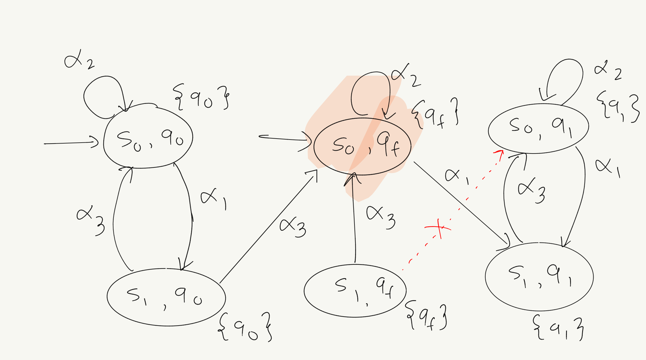
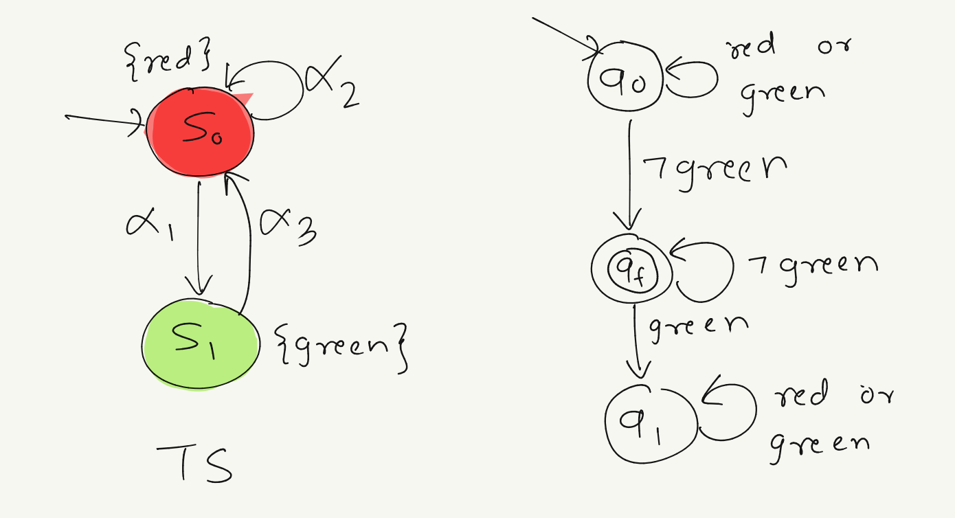
Example: $TS⊗A$
$$TS⊗A$$
$$TS$$
$$A$$
There is a cycle from initial state ${\left(s_{0},q_{f}\right)}^{ω}$ and another from $\left(s_{0},q_{0}\right)→\left(s_{1},q_{0}\right)→{\left(s_{0},q_{f}\right)}^{ω}$
$A$ captures $\boxed{\text{not}\text{ (}\text{infinitely} \text{often} \text{green}\text{)}}$. Because the resulting LTS has an accepting path, it means that
$$TS ⊭infinitely often green$$

Slide 50
Algorithms
$P_{persist}$ = eventually forever $Φ$
Theorem: Following two statements are equivalent:
$TS ⊭P_{persist}$
$∃s∈Reach\left(TS\right):s⊭Φ∧s is on a cycle in G(TS)$ (graph corresponding to $TS)$
Persistence encodes “bad behaviors”: we want to disprove persistence
Cycle detection:
Tarjan’s algorithm to decompose a graph into strongly connected components (SCCs): optimal w.r.t. asymptotic worst-case complexity
On-the-fly cycle detection algorithms using DFS-based cycle detection
Challenge: avoid quadratic time complexity

Slide 51
Naïve algorithms
$$visited≔∅ stack_{1} ≔∅ not_phis ≔∅;$$
foreach $\left(s∈I∖visited \right)$ do
add(visited ,$\left\{s\right\}$); // mark initial state as visited
$push\left({stack}_{1} , s\right); \text{// }\text{intiailize} \text{DFS} \text{stack}$
while $\left({stack}_{1}≠∅\right)$ do
$s^{′}≔top\left({stack}_{1}\right)$
if ($Post\left(s’\right)⊆visited$) then
$pop\left({stack}_{1}\right)$; // all states from $s′$ have already been visited
if $\left(s′⊭Φ\right)$ add($not_phis, s′)$ end if
else
pick $s^{′′}∈Post\left(s^{′}\right)∖visited$
push(stack₁ , $s′′$)
add(visited, $s′′$) // new reachable state
end if
end
end foreach

Slide 52
Nested DFS-based algorithm
boolean cycle_check($s$)
cycle_found $≔$false ${visited}_{2}$ $≔∅;$
$push\left({stack}_{2} , s\right)$
add(${visited}_{2}$ ,$\left\{s\right\}$)
while $\left({stack}_{2}≠∅∧¬ cycle_found\right)$ do
$s^{′}≔top\left({stack}_{2}\right)$
if ($s∈Post\left(s’\right)$) then
cycle_found $≔$true
$push\left({stack}_{2} , s\right)$
else
if ($Post\left(s’\right)⊆$ ${visited}_{2}$) then pop(${stack}_{2}$)
else
pick $s^{′′}∈Post\left(s^{′}\right)∖{visited}_{2}$
push(stack₂ , $s′′$) add(${visited}_{2}$, $s′′$) // new reachable state
end if
end if
end
return cycle_found
end foreach
$visited≔∅ stack_{1} ≔∅ not_phis ≔∅$ cycle_found := false
while $\left(I∖visited≠∅∧¬ cycle_found\right)$ do
pick $s∈I∖visited$
$push\left({stack}_{1} , s\right); \text{// }\text{intiailize} \text{DFS} \text{stack}$
add(visited ,$\left\{s\right\}$); // mark initial state as visited
while $\left({stack}_{1}≠∅∨¬cycle_found\right)$ do
$s^{′}≔top\left({stack}_{1}\right)$
if ($Post\left(s’\right)⊆visited$) then
$pop\left({stack}_{1}\right)$; // all states from $s′$ have already been visited
if $\left(s′⊭Φ\right)$ cycle_found $:=$ cycle_check($s’$) end if
else
pick $s^{′′}∈Post\left(s^{′}\right)∖visited$
push(stack₁ , $s′′$)
add(visited, $s′′$) // new reachable state
end if
end while
end foreach
Outer DFS : tries to reach all $¬Φ$ states
Inner DFS: tries to search backward edges lead to a $¬Φ$ state
reverse($stack_{2}.stack_{1}$) is the counterexample if cycle found
If not, $TS⊨P$

Slide 53
Run of nested DFS
$$Φ=¬q_{f}$$
boolean cycle_check($s$)
cycle_found $≔$false ${visited}_{2}$ $≔∅;$
$push\left({stack}_{2} , s\right)$
add(${visited}_{2}$ ,$\left\{s\right\}$)
while $\left({stack}_{2}≠∅∧¬ cycle_found\right)$ do
$s^{′}≔top\left({stack}_{2}\right)$
if ($s∈Post\left(s’\right)$) then
cycle_found $≔$true
$push\left({stack}_{2} , s\right)$
else
if ($Post\left(s’\right)⊆$ ${visited}_{2}$) then pop(${stack}_{2}$)
else
pick $s^{′′}∈Post\left(s^{′}\right)∖{visited}_{2}$
push(stack₂ , $s′′$) add(${visited}_{2}$, $s′′$) // new reachable state
end if
end if
end
return cycle_found
end foreach
Suppose the outer DFS algorithm starts at $(s_{0},q_{0})$
It will one by one add all states till it reaches $\left(s_{0},q_{1}\right)$
Then it will pop states one by one till it reaches $(s_{0},q_{f})$
None of these popped states satisfy $¬Φ$
Then it finds $\left(s_{0},q_{f}\right)$ that does satisfy $\backslash Phi$
This triggers cycle detection, which will find the cycle from $\left(s_{0},q_{f}\right)$ to itself

Slide 54
Other kinds of $ω$-automata
Same overall structure as a Büchi automaton, what differs is the way acceptance sets are defined and the resulting acceptance condition
Büchi variants
co-Büchi condition
Rabin condition
Streett condition
Muller condition
Parity condition

Slide 55
Acceptance conditions
Henceforth, instead of designating a set of “final” or “accepting” states, we will change the tuple to have an “acceptance condition” $α$
$A=\left(Q,Σ, δ,Q_{0},α\right)$
Run of the automaton: $ρ=q_{0}q_{1}⋯$ is defined as usual
Büchi condition :
$α⊆Q$
$ρ$ is accepting iff$inf\left(ρ\right)∩α≠∅$
Generalized Büchi condition:
$α=\left\{α_{1},α_{2},…, α_{k}\right\}$
$ρ$ is accepting iff $∀i :inf\left(ρ\right)∩α_{i}≠∅$

Slide 56
Weak Büchi automata
$A=\left(Q,Σ, δ,Q_{0},α\right)$
Special case of Büchi condition $α⊆Q$
Every strongly connected component (SCC) of the automaton is either contained in $α$ or disjoint from $α$
I.e., all SCCs are either all accepting end components or all rejecting end components

Slide 57
Limit Deterministic or Semi-Deterministic Büchi automata
$A=\left(Q,Σ,δ,Q_{0},α\right)$
Acceptance condition: $α⊆Q$
Acceptance condition is the same, but the automata has a special structure
Set of states $Q$ is union of two disjoint subsets $N$ and $D$, i.e., $Q=N⨄{D}$ b
Set of accepting states $α⊆D$
Automaton is deterministic for states in $D$, i.e., for all states $d ∈ D$, the automaton $(D,Σ, δ,\left\{d\right\},α)$ is deterministic

Slide 58
co-Büchi condition
co- Büchi automaton: $A=\left(Q,Σ, δ,Q_{0},α\right)$
co is an abbreviation for “complemented”
$α⊆Q$
$ρ$ is accepting iff $inf\left(ρ\right)∩α=∅$ [States of $α$ are rejecting]
Complement of an NBA is a co-Büchi automaton

Slide 59
Rabin condition
Rabin automaton: $A=\left(Q,Σ, δ,Q_{0},α\right)$
$α=\left\{\left(R_{1},G_{1}\right), …, \left(R_{k},G_{k}\right)\right\}$ where $R_{i}, G_{i}⊆Q$
$ρ$ is accepting iff $∃j∈\left[1,k\right]:\left(\left(inf\left(ρ\right)∩R_{j}=∅\right)∧\left(inf\left(ρ\right)∩G_{j}≠∅\right)\right)$
For some pair $\left(R_{j}, G_{j}\right)$ such that:
eventually always not red ($R_{j}$) [or not infinitely often red]
and
infinitely often green $\left(G_{j}\right)$

Slide 60
Streett condition
Rabin automaton: $A=\left(Q,Σ, δ,Q_{0},α\right)$
$α=\left\{\left(R_{1},G_{1}\right), …, \left(R_{k},G_{k}\right)\right\}$ where $R_{i}, G_{i}⊆Q$
$ρ$ is accepting iff $∀j∈\left[1,k\right]:\left(\left(inf\left(ρ\right)∩R_{j}=∅\right)∨\left(inf\left(ρ\right)∩G_{j}≠∅\right)\right)$
For all pairs $\left(R_{j}, G_{j}\right)$ :
eventually always not red ($R_{j}$) [or not infinitely often red]
or
infinitely often green $\left(G_{j}\right)$

Slide 61
Muller automaton
$A=\left(Q,Σ, δ,Q_{0},α\right)$
$α=\left\{α_{1},α_{2},⋯, α_{k}\right\}$
$ρ$ is accepting iff for some $i∈\left[1,k\right]: inf\left(ρ\right)=α_{i}$
I.e., one of the sets of states in the acceptance condition is exactly the set of states that appears infinitely often

Slide 62
Parity Automata
Two equivalent and alternate definitions:
$$A=\left(Q,Σ, δ, Q_{0}, α\right)$$
$α=\{S_{1},S_{2},…, S_{2k}\}$ where: $S_{1}⊂S_{2}⊂⋯⊂S_{2k}=Q$
$ρ$ is accepting iff:$min \{i∣ inf\left(ρ\right)∩S_{i}≠∅\}$ is even
$$A=\left(Q,Σ, δ, Q_{0}, C,λ, α\right)$$
$C$ is some finite set of colors: $\{1,…, k\}$
$λ:Q→C$ labels a state with a color ($λ(ρ)$: inf. seq. of colors for corr. states in $ρ$)
$ρ$ is accepting iff: $\min\left\{i ∣ inf\left(λ\left(ρ\right)\right)=i \right\}$ is even

Slide 63
Note about states vs. transitions
Some authors prefer to define accepting transitions instead of states
Transition-based Generalized NBA$A=(Q,Σ,δ,Q_{0},α)$
$α=\{α_{1},⋯, α_{k}\}$ where $α_{i}⊆Q×Σ×Q$
$ρ=q_{0}\underset{→}{a_{0}}q_{1}\underset{→}{a_{1}}⋯$
$inf \left(ρ\right)$ = set of transitions $(q_{i},a_{i},q_{i+1})$ appearing infinitely often
$ρ$ is accepting iff $∀i: inf\left(ρ\right)∩α_{i}≠∅$
We can define transition-based acceptance for all kinds of automata. It is possible to go from one form to another.
Why? It actually makes product with an LTS easier to define (left as an exercise)!

Slide 64
Why do we need so many automata?
Expressive power
Succinctness (Size of the automaton to express the same $ω$-language)
Ease of complementation
Use in various applications (model checking, reactive program synthesis, games, etc.)

Slide 65
Expressive power
The nondeterministic ones:
NBA, LDBA, GNBA, Parity, Rabin, Street, Muller all recognize $ω$-regular languages
Nondeterministic weak Büchi and co-Büchi automata are strictly weaker
The deterministic ones:
Deterministic Parity, Rabin, Streett, Muller all recognize $ω$-regular languages
Deterministic Büchi automata, co-Büchi and weak Büchi automata are strictly weaker

Slide 66
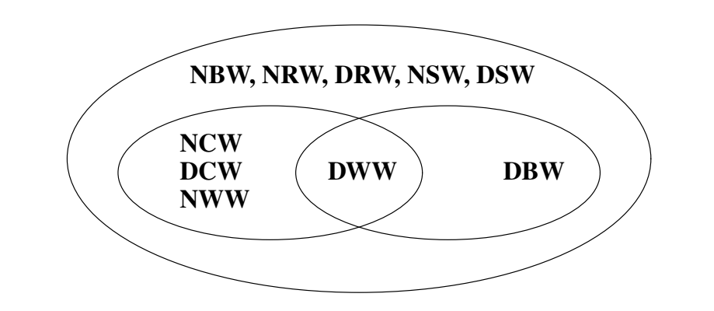
Expressiveness hierarchy
In this diagram the “W” at the end indicates “word” automata.
E.g.,
NCW = Nondeterministic co-Büchi Word Automaton
Figure reproduced from “Typeness for $ω$-regular automata” by Kupferman, Morgenstern and Murano

Slide 67
Conversion between automata
We have $β=\left\{D,N\right\}$, $γ=\left\{W,B,P,S,R,M\right\}$ so we have many conversions possible from an automaton of type $β_{1}γ_{1}A$ to $β_{2}γ_{2}$A
Many results!
Generally:
NB $→$ NR/NS/NP : no blow-up
NR $→$ NB : polynomial blow-up in number of states and pairs
NS/NM $→$ NB : exponential blow-up
NB $→$ DR/DP : exponential blow-up
Determinization of nondeterministic Büchi automata uses a famous result known as Safra’s construction

Slide 68
Complexity of various operations
Operation
 | Deterministic Automata Size Blow-up |  |  | Nondeterminsitic Automata Size Blow-up |  |  | Non-emptiness
 | Union | Intersection | Complement | Union | Intersection | Complement | Non-emptiness
Weak | Quadratic |  | No | Linear | Quad. | $2^{Θ(n)}$ or impossible | NL-complete
co-Büchi |  |  | No or Impossible
Büchi |  |  | No or Impossible |  |  | $2^{Θ(n\log{n})}$
Parity | Exponential state, size |  | No |  | Quad.-Quartic |  | $O(|δ|\log{k})$, NL-complete
Rabin | Quad | Exp | Exponential |  | Quad. | $2^{Θ(n^{2}\log{n})}$ | $$O(\left|δ\right|k)$$ NL-complete
Streett | Exp | Quad |  |  |  |  | P-complete
Muller | Exp | Exp |  |  | Exp. | Double. Exp. | NL-complete
Automaton
Table reproduced from: “Why These Automata Types?” by Udi Boker

Slide 69
Bibliography
C. Baier, J. P. Katoen, Principles of Model Checking, MIT Press
U. Boker, Why These Automata Types? Int. Conf. on Logic for Programming, AI and Reasoning (LPAR 2022)
O. Kupferman, G. Morgenstern, A. Murano, Typeness for $ω$-regular automata, in Proc. of ATVA 2004.
S. Sickert, J. Esparza, S. Jaax, J. Křetínský, Limit-Deterministic Büchi Automata for Linear Temporal Logic, in Proc. of CAV 2016.
https://en.wikipedia.org/wiki/%CE%A9-automaton

Slide 70
Intersection (Product) $A_{1}⊗A_{2}$
Weak and co-Büchi automata:
Intersection done directly on the product automaton
State $(s,q)$ accepting iff $s$ is accepting in $A_{1}$ and $q$ is accepting in $A_{2}$
When both intersecting automata are of the same type, the product automaton retains the property
For weak: runs of both $A_{1}$ and $A_{2}$ eventually remain in only accepting states
For co-Büchi: runs of both $A_{1}$and $A_{2}$ eventually remain in only rejecting states
Büchi condition:
Need two copies of the automaton (and jump from one set to another)
Parity condition:
convert to NBA with quadratic blow-up
intersect (results in quartic blow-up and an NBA)

Slide 71
Intersection (Product) $A_{1}⊗A_{2}$
Streett condition:
Intersection can be done directly on the product automaton
Rabin condition:
Direct intersection using some involved copies of the automata: quadratic size blow-up
Muller condition:
Muller $→$ Büchi cubic size blow-up
But converting back to Muller may involve exponential blow-up

